Slide 1

Liver Cirrhosis Prediction with XGBoost & EDA

Slide 2
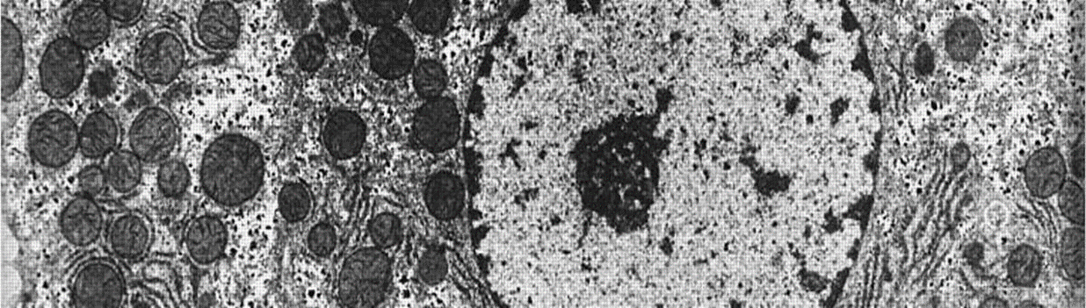
ABSTRACT
This research addresses the growing concern of liver cirrhosis in North America, predominantly linked to alcohol consumption. Leveraging advanced machine learning techniques, we aim to develop a comprehensive predictive model by integrating lifestyle factors (such as alcohol consumption, dietary habits, and exercise) and health indicators (including viral hepatitis status and liver function tests).
Index Terms: Liver Cirrhosis, Predictive Modelling, Risk Assessment, Alcohol Consumption, Lifestyle Factors, Health Indicators

Slide 3
LITERATURE SURVEY
Traditional medical studies on liver cirrhosis rely on information obtained through personal contact with healthcare professionals.
Recent research has demonstrated the potential of utilizing social media data for studying mental health conditions , but there's limited exploration in the context of liver cirrhosis.
We focus on liver cirrhosis, a serious condition affecting millions globally, with particular prevalence among certain groups such as chronic alcohol users. We introduce a novel method for building a cirrhosis classifier, offering cost-effective training data compared to conventional approaches.

Slide 4
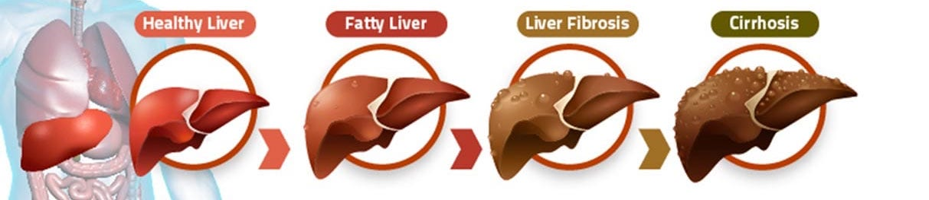
PROBLEM STATEMENT
Liver cirrhosis is a big problem globally, especially in North America, where more people are getting it, mostly because of drinking alcohol. Even though doctors know more about it now, we still need better ways to find it early and figure out who's at risk. This problem statement is about making a smart tool that can predict if someone might get cirrhosis by looking at their lifestyle and health, so doctors can help them before it gets worse.

Slide 5

EXISTING SOLUTION
Traditional methods for the prediction of liver cirrhosis are the gradient boosting methods
But unfortunately these machine learning models are not so much efficient when compared to other machine learning algorithms
Which can be subjected to time- consuming and may depend on other physiological measures which can be invasive and require specialized equipment. These methods also require significant expertise to interpret the data accurately.

Slide 6
DISADVANTAGES
Accuracy:
The accuracy is one of the major entity which can effect the entire outcome of the project
Time:
Due to the usage of old machine learning algorithm, the time consumption is higher than the new algorithm

Slide 7

PROPOSED SOLUTION
Usage of latest algorithms line XGBoost (Extreme Gradient Boosting Algorithm) and EDA ( Exploratory Data Analysis ) may help to increase the accuracy and reduce the time consumption

Slide 8

SYSTEM REQUIREMENTS
Hardware requirements:
Operating System :Windows, Linux
Processor :Minimum intel i3
RAM : Minimum 4GB
Software requirements:
Jupyter Notebook, Google Colab, Modules like Numpy, Pandas, Matplotlib, Seaborn

Slide 9




MODULES
matplotlib
Pandas
seaborn
NumPy
High-performance, easy-to-use
data structures and data
analysis tools, particularly
designed for working with
structured data
Numerical computing that
provides support for large,
multi-dimensional arrays and
matrices
Creating static, interactive,
and animated visualizations in
various formats,including line
plots, scatter plots, bar charts,
histograms, and more.
Statistical data visualization
library in Python that simplifies
the creation of complex and
visually appealing plots.

Slide 10
1
1 - Requirements Gathering and Analysis
8 - Maintenance and Monitoring
8
2
2 - Data Collection and Preprocessing
SDLC
7 - Documentation
7
3
3 - Exploratory Data Analysis (EDA)
6 - Testing
6
4
4 - Model Selection and Development
5
5 - Model Deployment

Slide 11
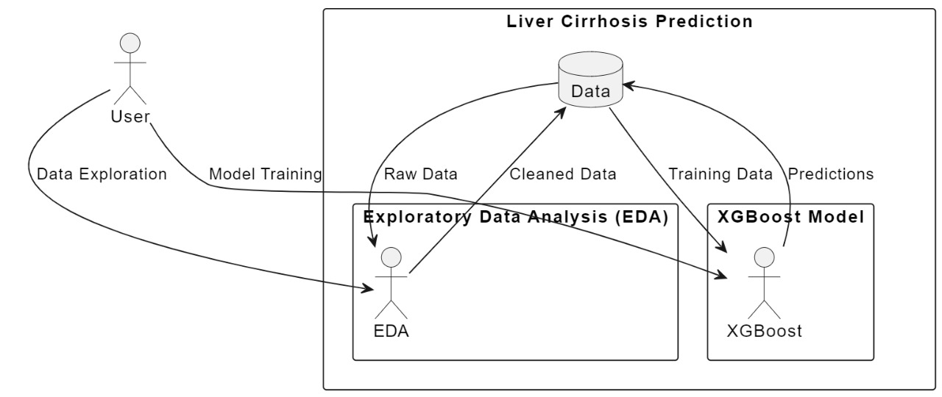
SYSTEM ARCHITECTURE

Slide 12
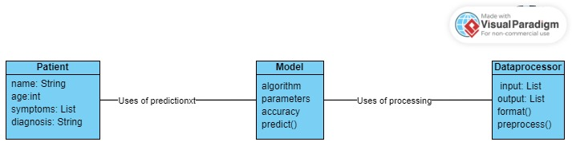
CLASS DIAGRAM

Slide 13
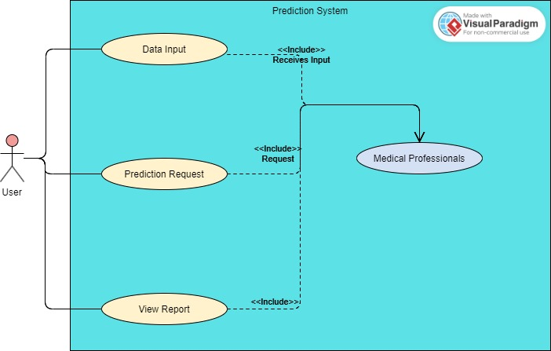
USE CASE DIAGRAM

Slide 14
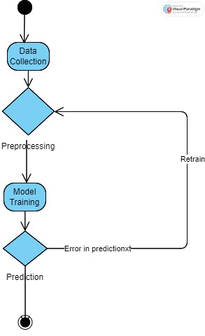
ACTIVITY DIAGRAM

Slide 15
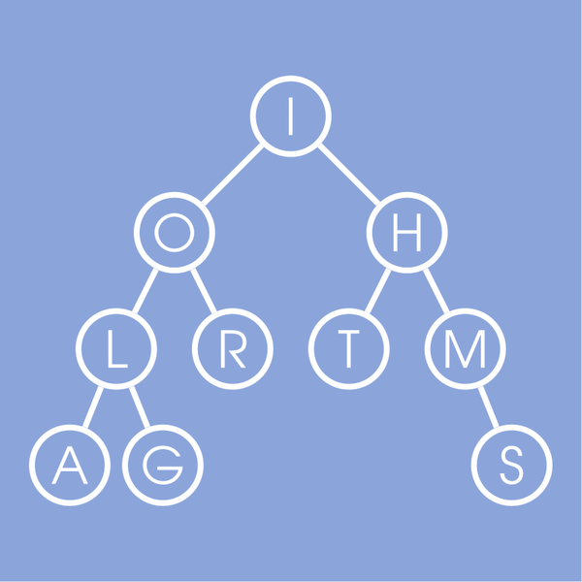
Algorithms

Slide 16
Exploratory Data Analysis (EDA)
Exploratory Data Analysis (EDA) refers to the method of studying and exploring record sets to apprehend their predominant traits, discover patterns, locate outliers, and identify relationships between variables. EDA is normally carried out as preliminary step before undertaking extra formal statistical analyses or modeling
Steps in EDA :
Data Cleaning
Descriptive Statistics
Data Visualization
Feature Engineering
Correlation and Relationships
Data Segmentation
Hypothesis Generation
Data Quality Assessment

Slide 17
XGBoost (Extreme Gradient Boosting)
When it comes to a superfast Machine Learning algorithm that works on tree-based
models and tries to reach the best in class accuracy by optimally using
computational resources, XGBoost or Extreme Gradient Boosting becomes the most
natural choice. Created by Tianqi Chen, the XGBoost algorithm has recently got so
much popularity owing to its massive usage in most of the hackathons and Kaggle
competitions.
In simple terms, XGBoost may be formally defined as a decision tree-based
ensemble learning framework that uses Gradient Descent as the underlying
objective function and comes with a lot of flexibility while delivering the desired
results by optimally using computational power

Slide 18
Steps in XGBoost
Building Decision Tree Sequentially :
XGBoost starts by training a basic decision tree on your data. This initial tree makes some errors in predictions.
Focusing on Errors:
The algorithm then analyzes the errors made by the first tree and creates a second decision tree that specifically targets those errors.
Boosting the Ensemble:
This process of building decision trees that correct the mistakes of previous ones continues iteratively. Each new tree is added to the ensemble, gradually improving the overall prediction accuracy.
Regularization to Prevent Overfitting:
XGBoost incorporates regularization techniques to prevent the model from overfitting to the training data. This helps it generalize better to unseen data.

Slide 19
Code Implementation

Slide 20
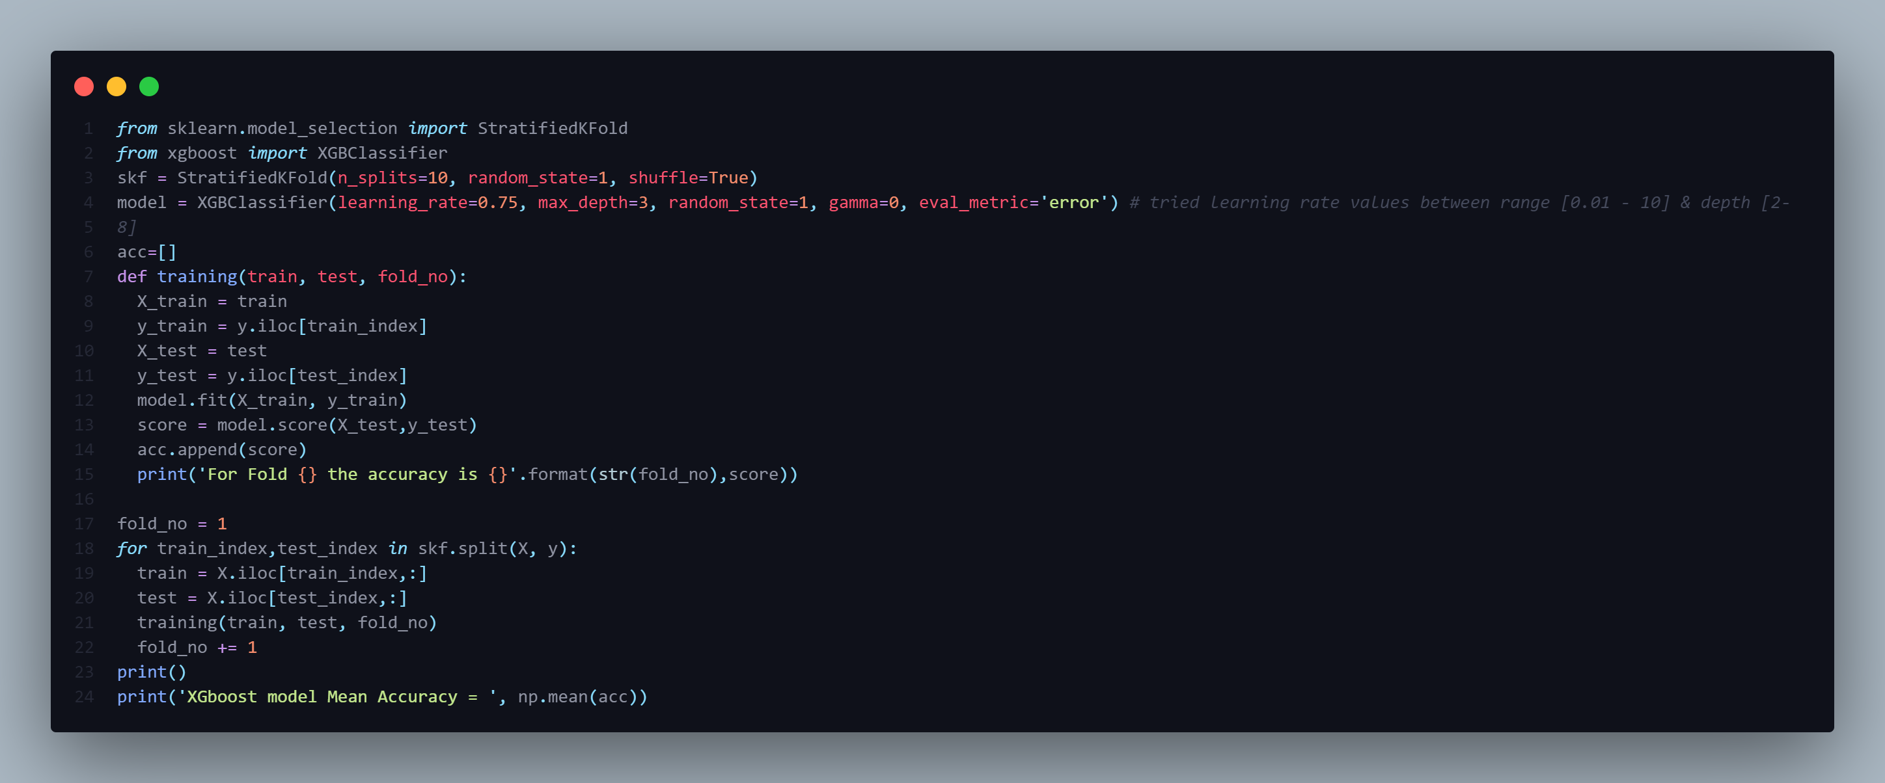

Slide 21
Thank you

